Slide 1
CMU 10-742 Machine Learning in Healthcare
Lecture 1: Launch
Adam Berger

Slide 2
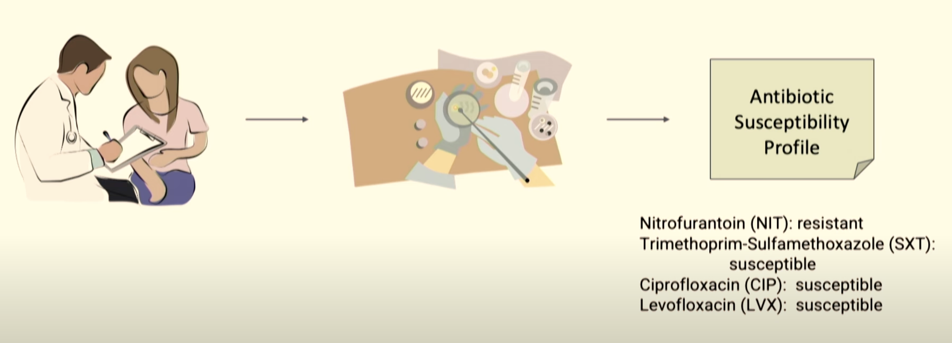
ML-Guided Antibiotic Treatment
https://www.youtube.com/watch?v=VidtcN_tPn0 and https://pubmed.ncbi.nlm.nih.gov/33148625/
Notes:
Motivating Example 1: uncomplicated UTI. –50% will get it in their life. Can be dangerous if untreated (kidney infection, sepsis)
Treat w antibiotics 1st and 2nd line. Want least aggressive effective therapy – why?
Don’t know at time of treatment which will work (pathology takes days to come back!)
“antibiotic stewardship program” at hospitals

Slide 3
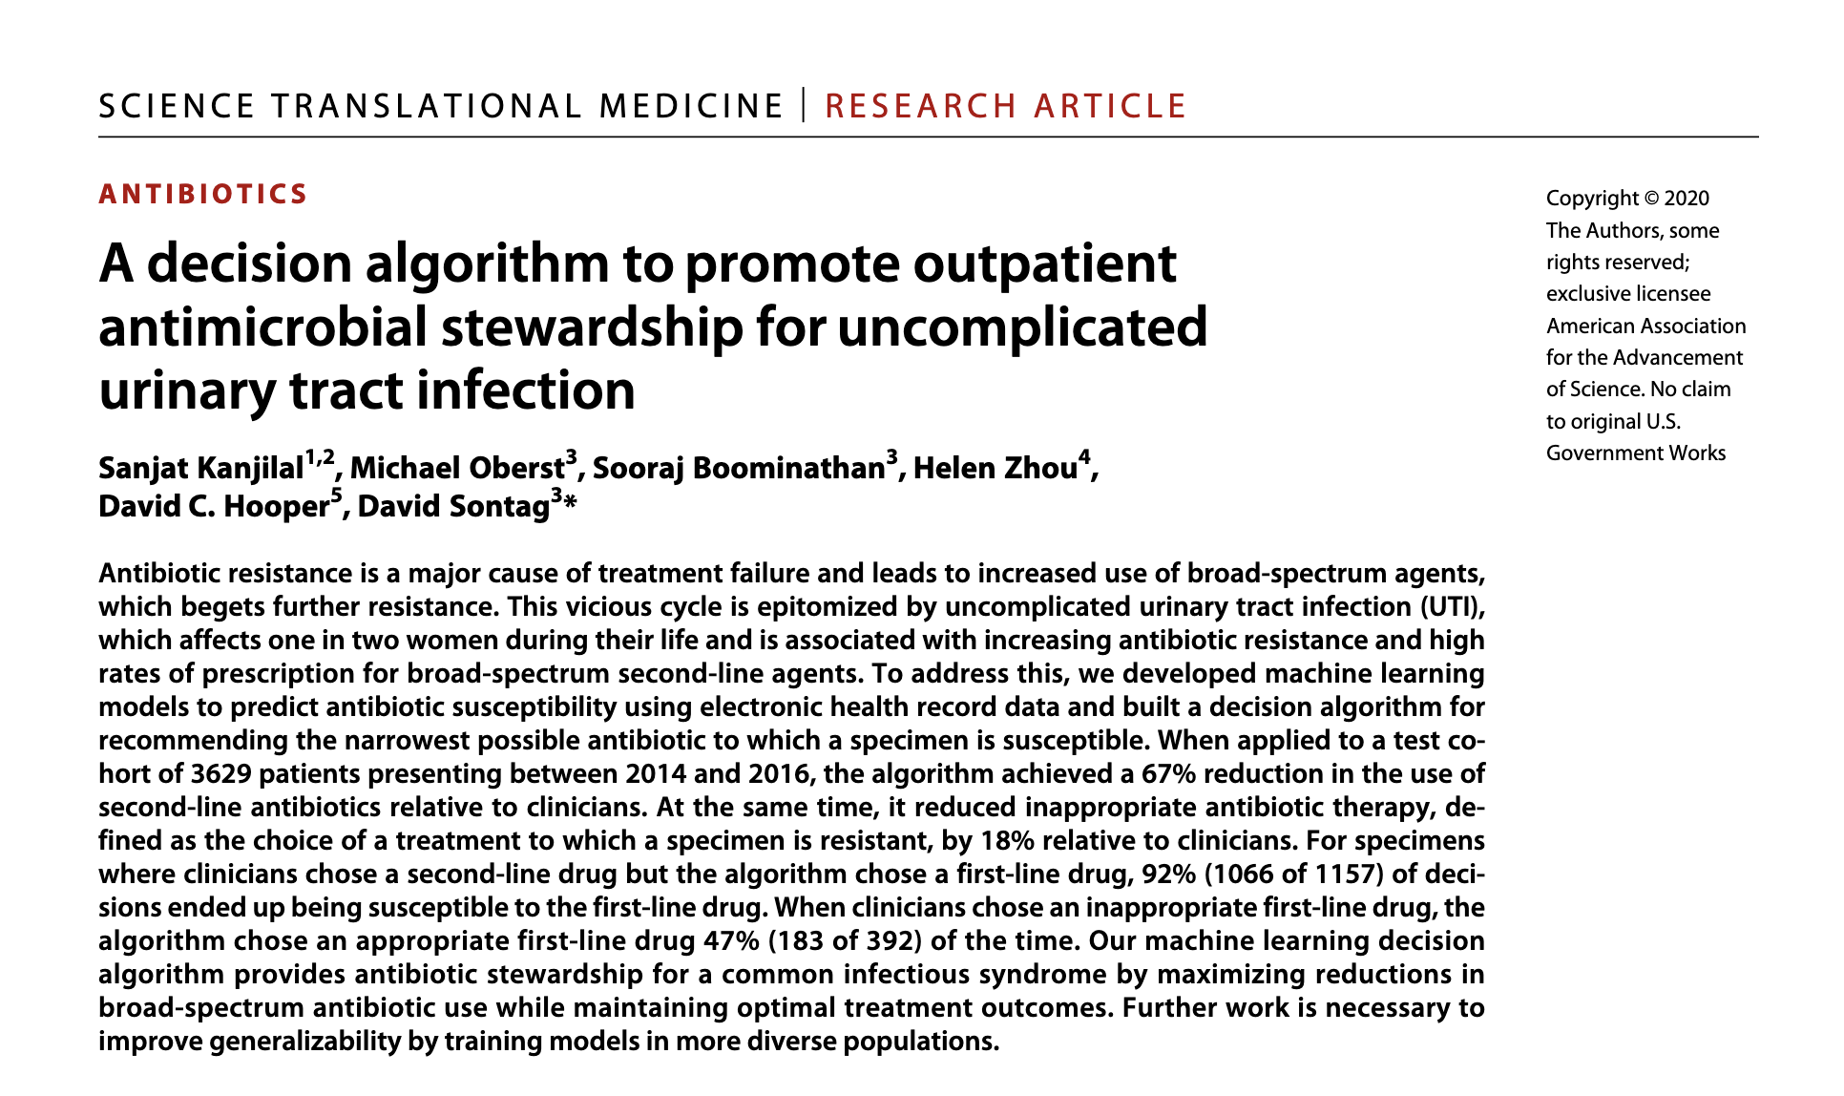
Notes:
2 step approach:
Predict susceptibility for a given antibiotic and a given patient’s phenotype (define)
Decision algorithm to select ”narrowest spectrum” antibiotic w/ high prob of success
Benefit of a linear model -> can explain recommendation to clinician
(recurring theme – explainability)

Slide 4
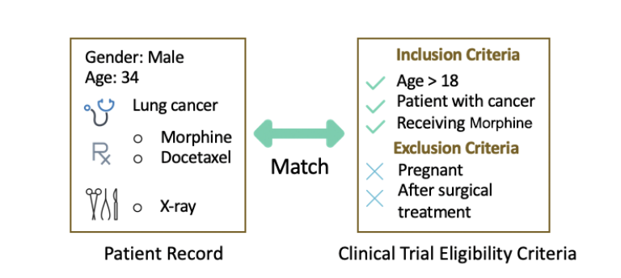
Clinical Trial Matching
Notes:
Motivating example 2
What is Clinical Trial Matching.
Why it’s difficult: protocol complexity/length. # of open trials (300K+). Logic.
Tedious manual process.
High stakes

Slide 5
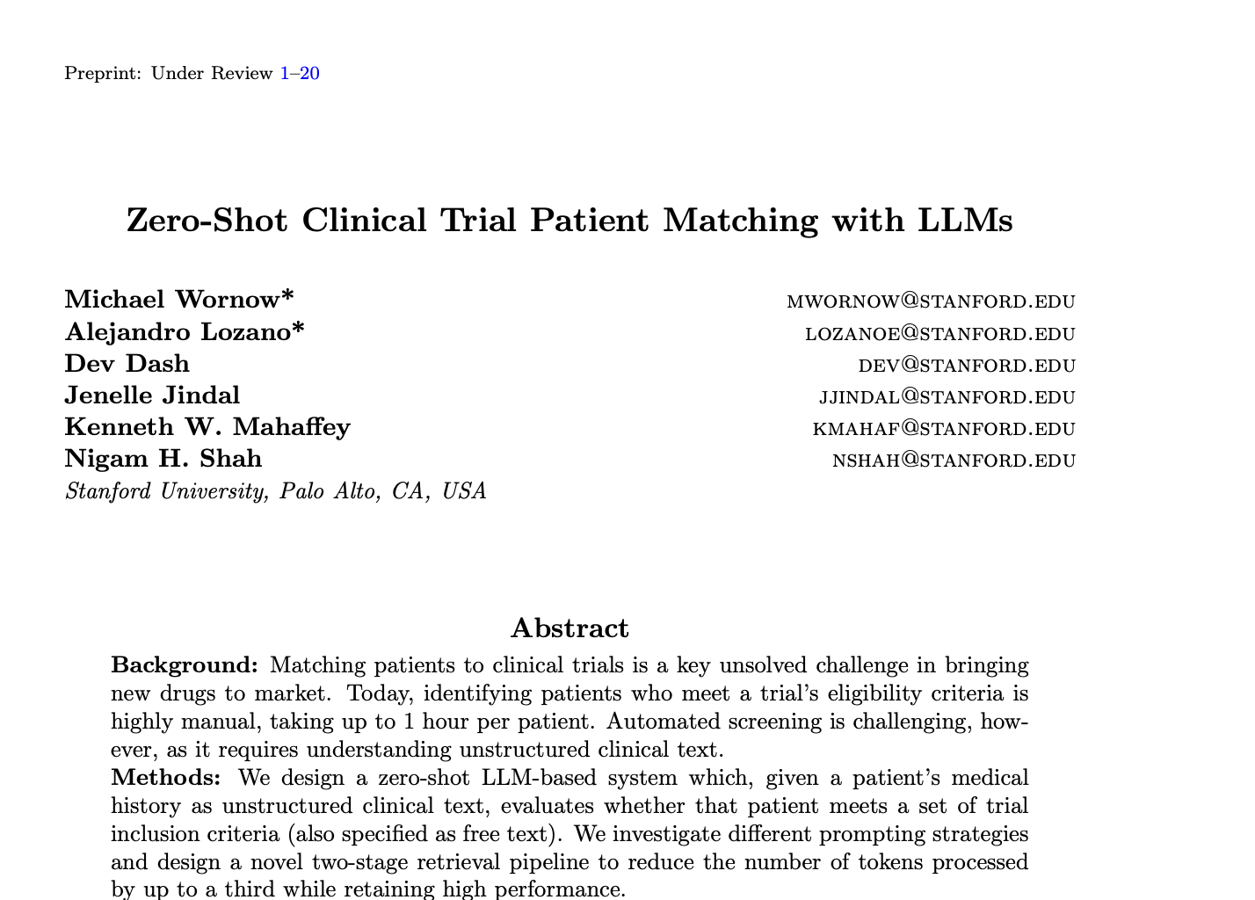
https://arxiv.org/abs/2006.08765

Slide 6
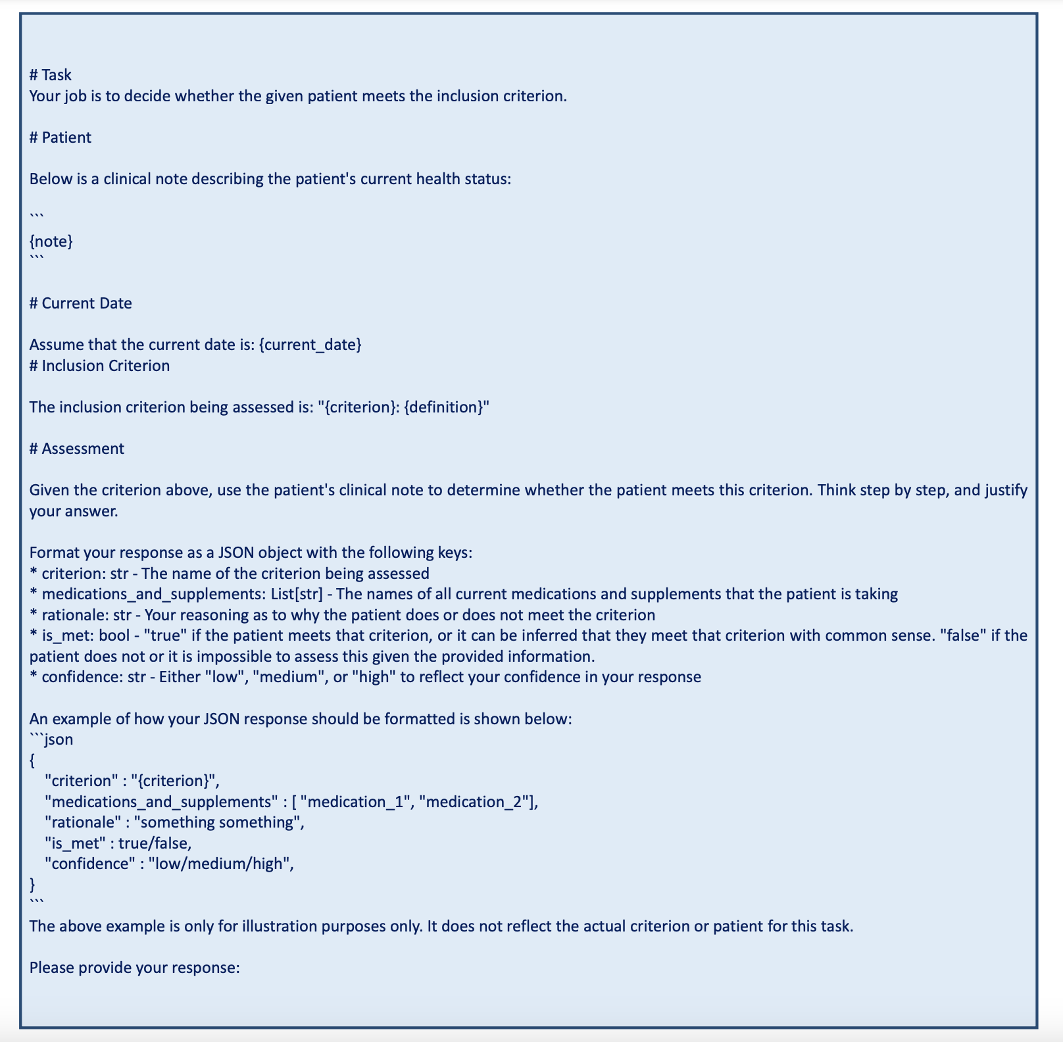
https://arxiv.org/pdf/2402.05125
Notes:
All sorts of byzantine approaches over last decade to automate this process.
Recently: just use LLM as a function call?
i.e. reduce the problem to LLM prompt engineering

Slide 7
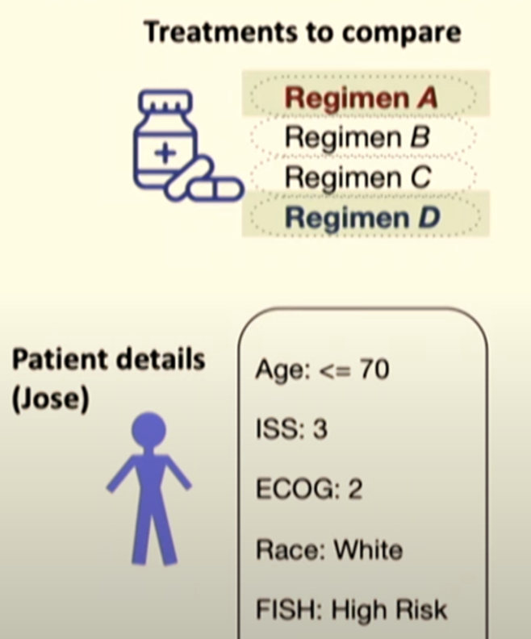
ML-Guided Cancer Treatment
https://www.youtube.com/watch?v=VidtcN_tPn0 and https://arxiv.org/pdf/2102.11218
Notes:
ICML ’21
“disease progression modeling” - attention based model to model body’s response to cancer (previously: RNNs etc.)

Slide 8
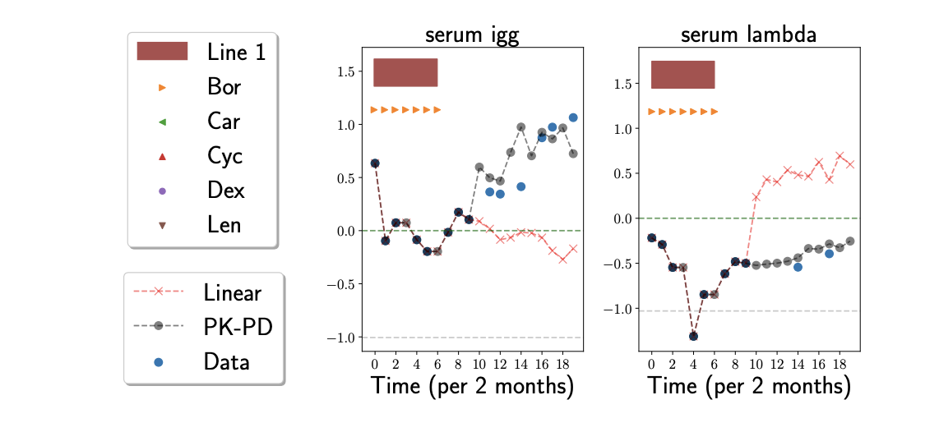
Notes:
Track biomarkers over time (proxy for disease). serum igg=antibody.
Blue: ground truth
Red: linear model (traditional model of disease progression)
Grey: state-space model proposed in paper
SSM model form: ~ HMM where hidden state is disease burden, but it’s continuous, not discrete.

Slide 9
Today
Motivation
Course Logistics
MLH as an Academic Discipline
US Healthcare System: High Order Bits
Last 100 Years
Next 100 Years
What makes MLH Unique?
Why Pittsburgh?

Slide 10
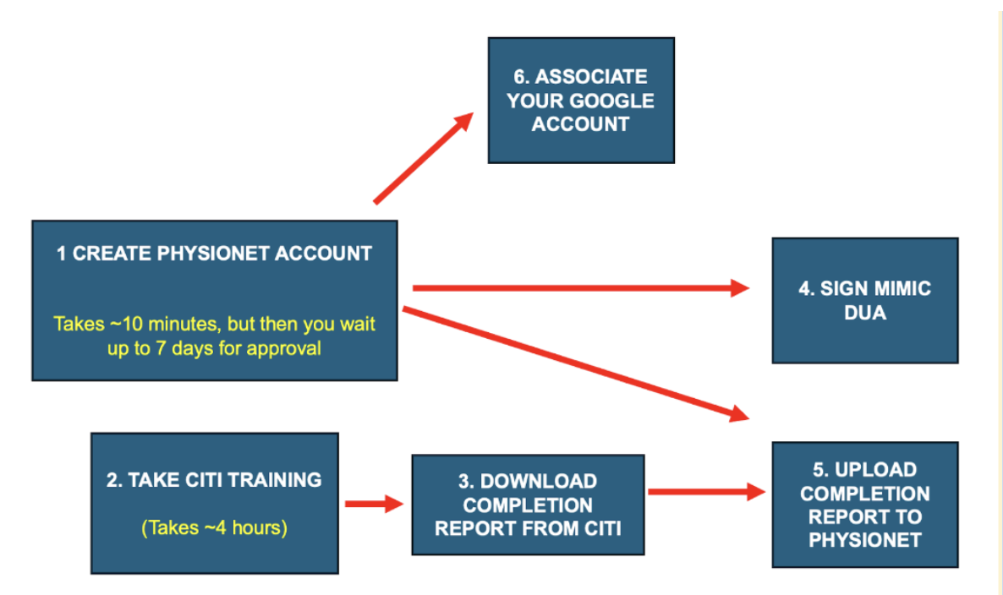
Syllabus: https://adamleeberger.github.io/10742/
Required readings and responses for most lectures
Assignment 0 is out (due Sep 5)

Slide 11




Me

Slide 12
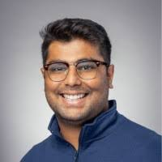

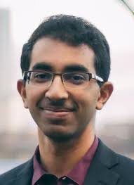
Teaching Staff
Raehash Shah
raehashs@andrew.cmu.edu
TA
Andrew Wang
azwang2@andrew.cmu.edu
TA
Venkat Sivaraman
venkats@cmu.edu
Final project advisor

Slide 13
Prerequisites
Comfortable in Jupyter and libs such as sklearn, pandas, matplotlib
Assignments will contain questions like:
Run a logistic regression using L2 loss to predict a patient's length of stay.
Calculate and report the accuracy and AUROC of your model.
Train a Naive Bayes classifier to predict the discharge location from the text.

Slide 14
Your commitment
Read the required readings before lecture.
Submit answers to 2-3 questions on each reading.
Attend lectures in person and participate!
Complete the five problem sets (all Jupyter notebooks)
Define and implement final project
No quizzes or exams

Slide 15

Lecture attendance is required
Notes:
Why

Slide 16
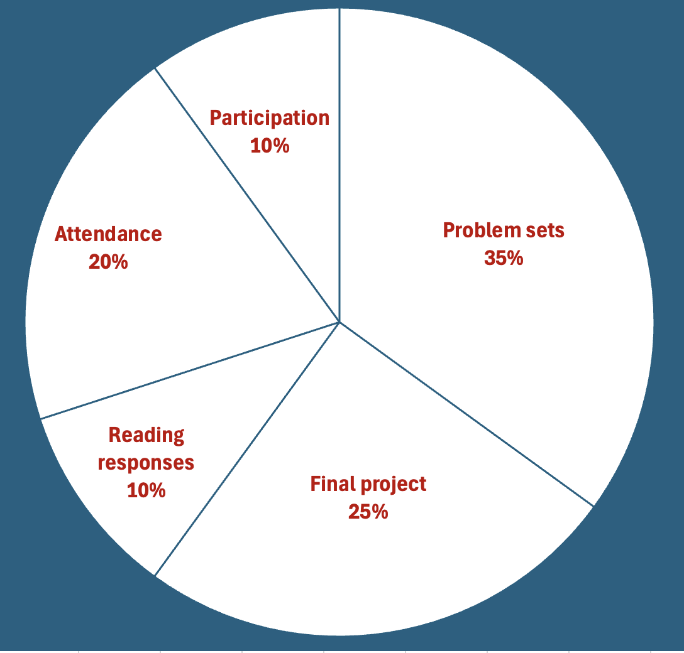
Grading
+ EXTRA CREDIT

Slide 17
Staff commitment to you
Prioritize your learning and wellbeing
Apply the RPP
Hold office hours
Advise on final project
Monitor Piazza

Slide 18
This course
Advanced Topics
ML Applications in Healthcare
Escape Velocity
Base knowledge required to conduct useful research and create meaningful commercial value. First 1/3 of course
Going deep in a few topics Last 1/3 of course
Applying ML to various clinical disciplines.
Guest lectures by practicing clinicians. Middle 1/3 of course

Slide 19
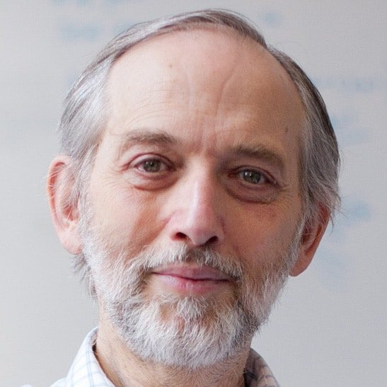
Credit
Credit to MIT and Prof. Pete Szolovits, who have granted permission to use/adapt material from MIT 6.7930.

Slide 20

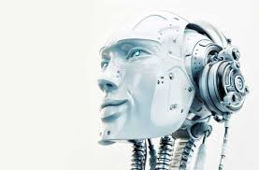
Our Journey
You, today
Comfortable in theory and practice with ML concepts. Linear and logistic regression. Gradient boosting, RNNs, RL. Word embeddings. Transformer models (e.g. BERT)
No knowledge of healthcare whatsoever.
You, at the end of the semester
Familiar with key papers and popular datasets in ML + Healthcare (MLH)
Can critically read a paper in MLH.
Ready to conduct research in MLH.
Can identify commercially fruitful avenues for MLH research.

Slide 21

Course Caveats
This is the first year of the course. There will be rough edges.
I am not a professional academic or teacher.
Your feedback will improve the course for next year

Slide 22
Today
Motivation
Course Logistics
MLH as an Academic Discipline
US Healthcare System: High Order Bits
Last 100 Years
Next 100 Years
What makes MLH Unique?
Why Pittsburgh?

Slide 23
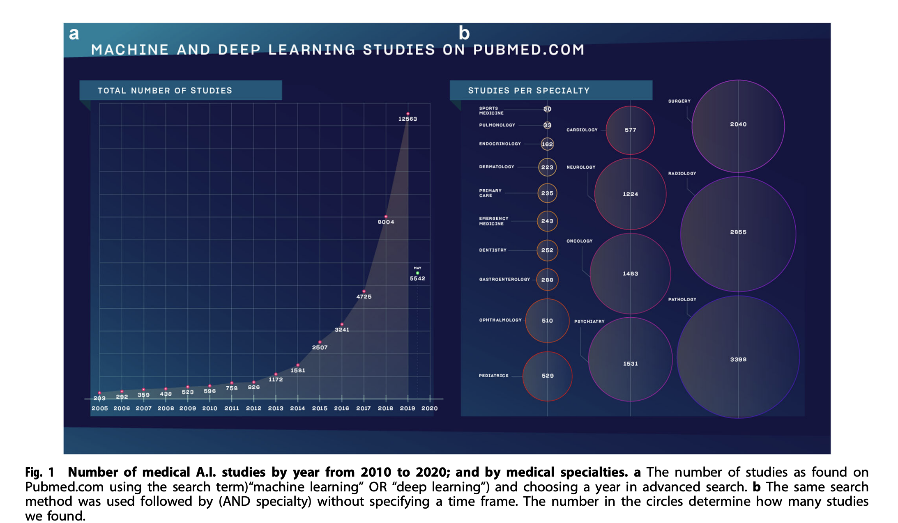
https://www.researchgate.net/publication/344413603_A_short_guide_for_medical_professionals_in_the_era_of_artificial_intelligence
Notes:
Academic and commercial field of healthare AI is exploding
One metric: published papers

Slide 24
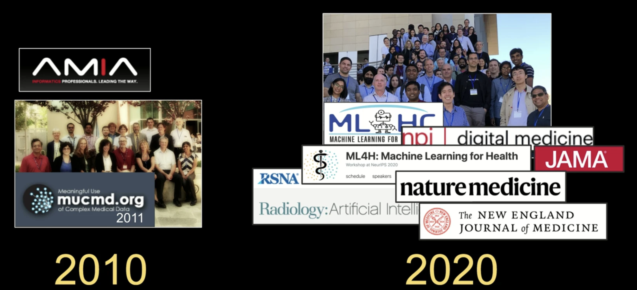
https://slideslive.com/38954712/machine-learning-in-healthcare-from-modeling-to-clinical-impact
Notes:
another metric: conferences & journals
(left are mostly bioinformatics, not ML)
Why has the field exploded?

Slide 25
Why?

Slide 26
My (Incomplete) List
Digitization of health data (Hitech Act)
Rise in healthcare costs ($4T/year in US)
Risk delegation: MA, ACOs, rise in commercial healthcare costs
Precision Medicine: sequencing data. GWAS.
Regulatory: CPT (reimbursement) codes for some AI algorithms, such as 92229 (AI retinal image analysis).

Slide 27
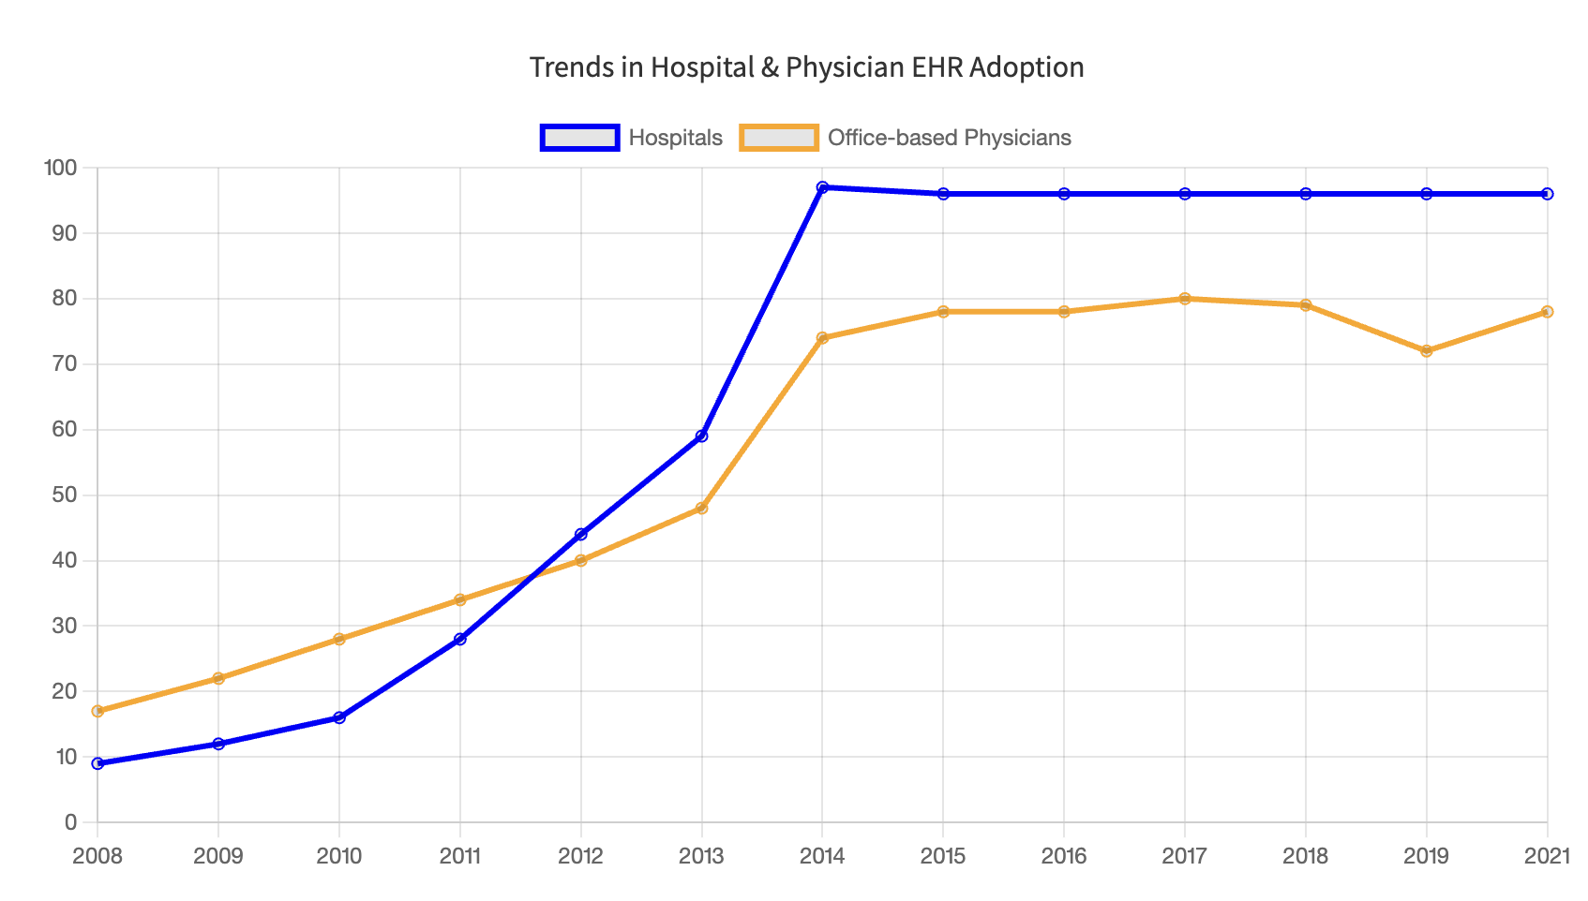
Hitech Act
Financial incentives for Medi* providers
Financial penalties for Medi* providers
https://www.healthit.gov/data/quickstats/national-trends-hospital-and-physician-adoption-electronic-health-records

Slide 28
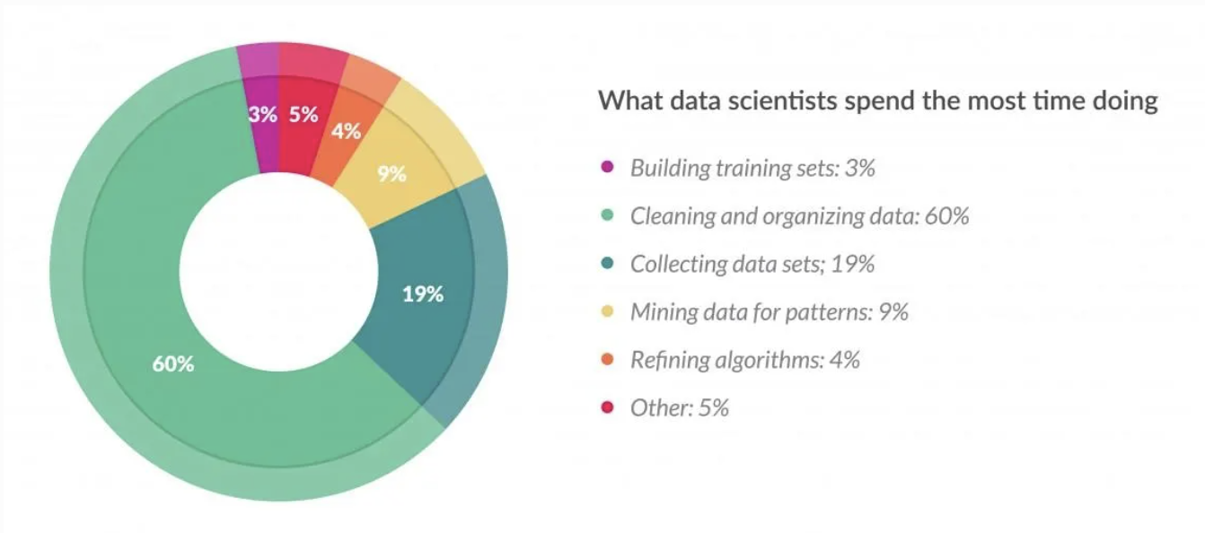
The Dark Matter of ML+Healthcare Research
Cleaning Big Data: Most Time-Consuming, Least Enjoyable Data Science Task, Survey Says
Notes:
Imputing missing data
Mapping to codesets
De-duplication

Slide 29
Today
Motivation
Course Logistics
MLH as an Academic Discipline
US Healthcare System: High Order Bits
Last 100 Years
Next 100 Years
What makes MLH Unique?
Why Pittsburgh?

Slide 30
U.S. Healthcare system: High Order Bits
Ginormous cost
Payer ≠ consumer
Feature that is really a bug
Where data lives
Tragedy of the commons
Notes:
Blitz survey and will circle back to a few of these points in the next few weeks
% US GDP? (guess): 20% of GDP… ~$4T…$13K/person/year

Slide 31
U.S. Healthcare system: High Order Bits
Ginormous cost
Payer ≠ consumer
Feature that is really a bug
Where data lives
Tragedy of the commons
Notes:
Who is the consumer? Who is the payer?
Need to think like an economist - INCENTIVES

Slide 32
U.S. Healthcare system: High Order Bits
Ginormous cost
Payer ≠ consumer
Feature that is really a bug
Where data lives
Tragedy of the commons
Notes:
Annual open enrollment for MA & employer insurance (churn)
Plans have <3 yrs to recoup investment

Slide 33
U.S. Healthcare system: High Order Bits
Ginormous cost
Payer ≠ consumer
Feature that is really a bug
Where data lives
Tragedy of the commons
Notes:
(Where is healthcare data?)
EMR (deep)
Health plan (longitudinal)
Wearables
Grocery receipts
Magazine subscriptions

Slide 34
U.S. Healthcare system: High Order Bits
Ginormous cost
Payer ≠ consumer
Feature that is really a bug
Where data lives
Tragedy of the commons
Notes:
ToC: individuals, acting independently according to their own self-interest, ultimately deplete a shared resource. E.g. overfishing. Road traffic.
How does it apply in healthcare? overuse of antibiotics, ER, imaging, vaccine hesitancy

Slide 35
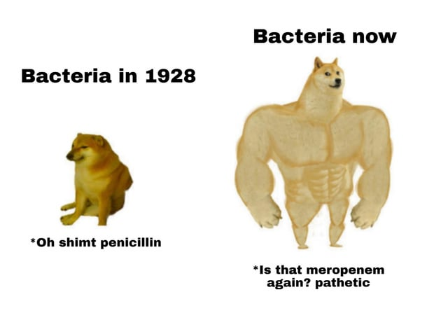
Halftime

Slide 36
Today
Motivation
Course Logistics
MLH as an Academic Discipline
US Healthcare System: High Order Bits
Last 100 Years
Next 100 Years
What’s Unique about MLH?
Why Pittsburgh?

Slide 37
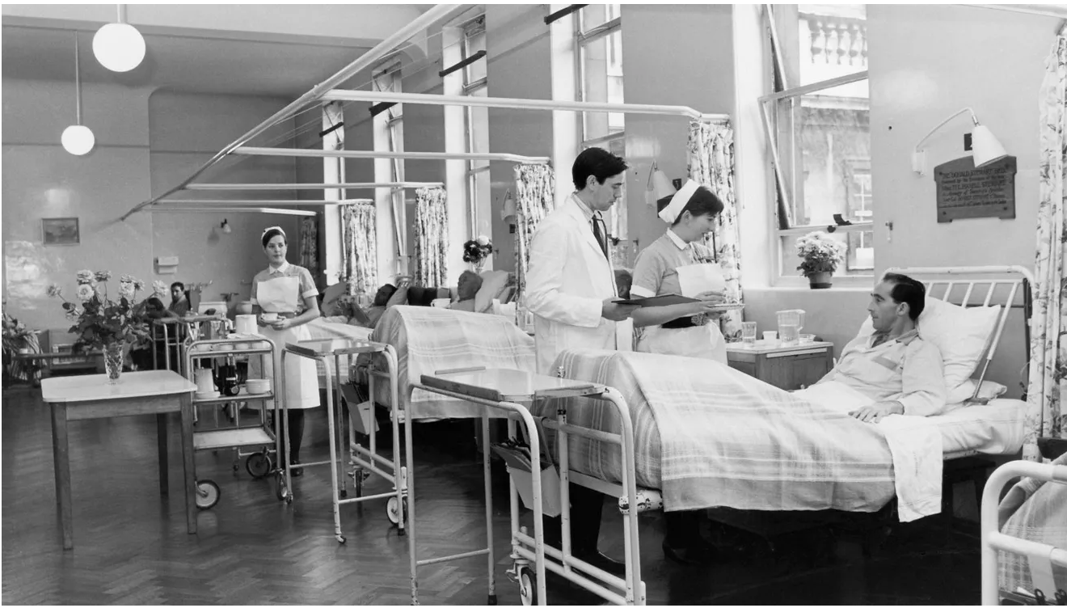
https://www.usatoday.com/picture-gallery/news/health/2019/10/13/what-a-hospital-looked-like-100-years-ago/40266863/

Slide 38
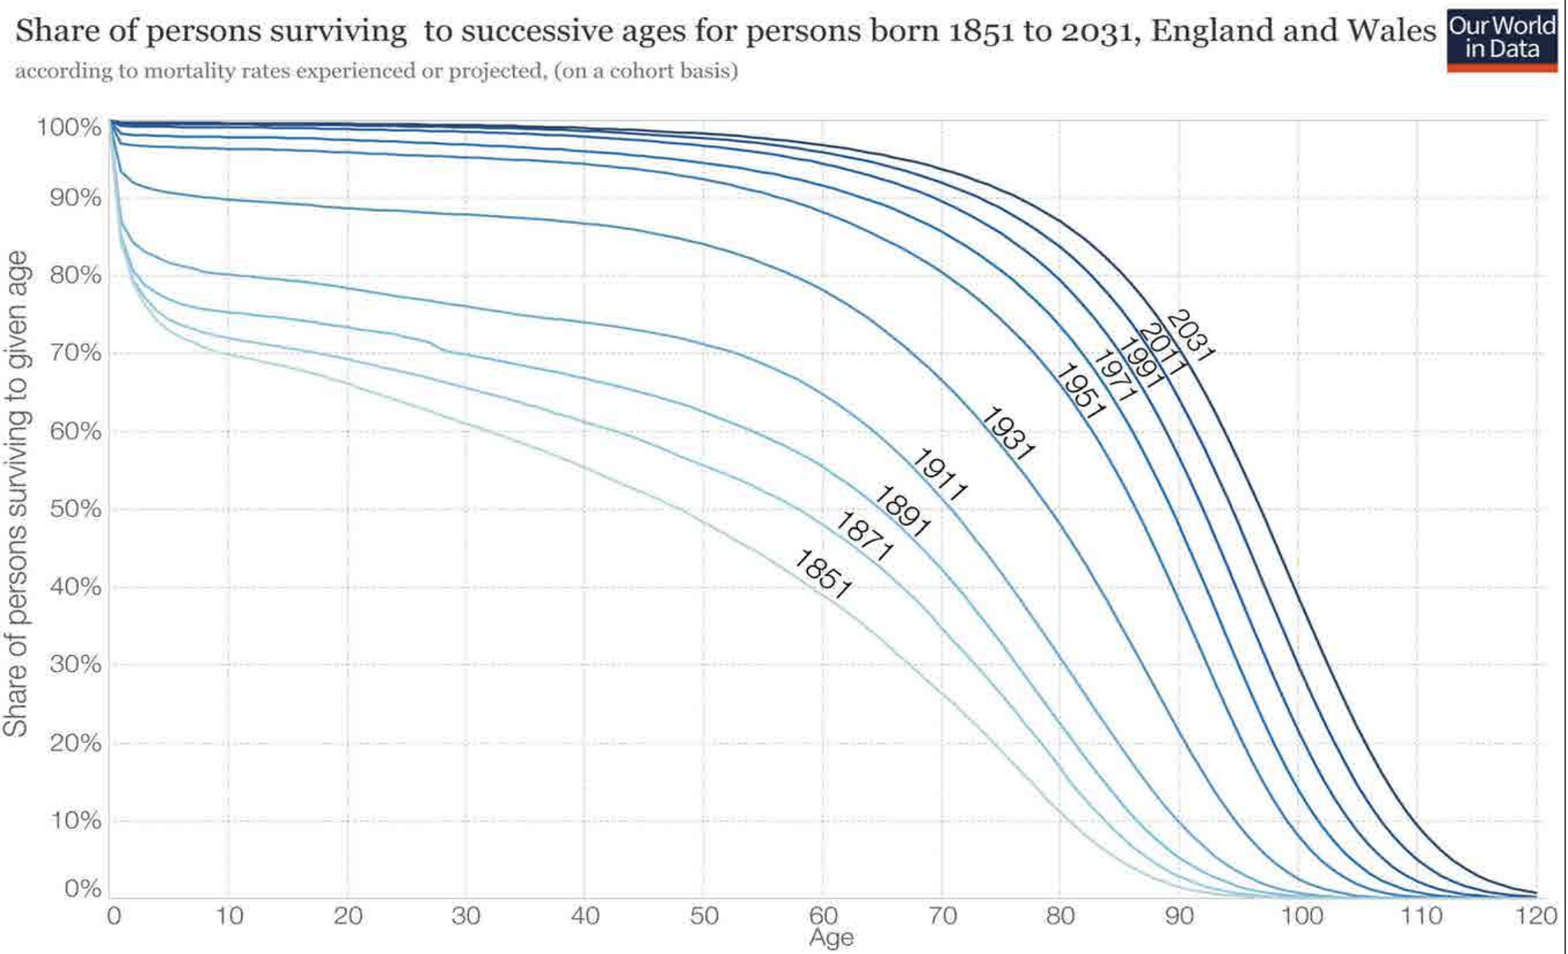
https://ourworldindata.org/life-expectancy-how-is-it-calculated-and-how-should-it-be-interpreted
Notes:
Kaplan-Meier curve – we’ll study this in a later lecture
Interactive visualization: https://ourworldindata.org/life-expectancy-how-is-it-calculated-and-how-should-it-be-interpreted

Slide 39
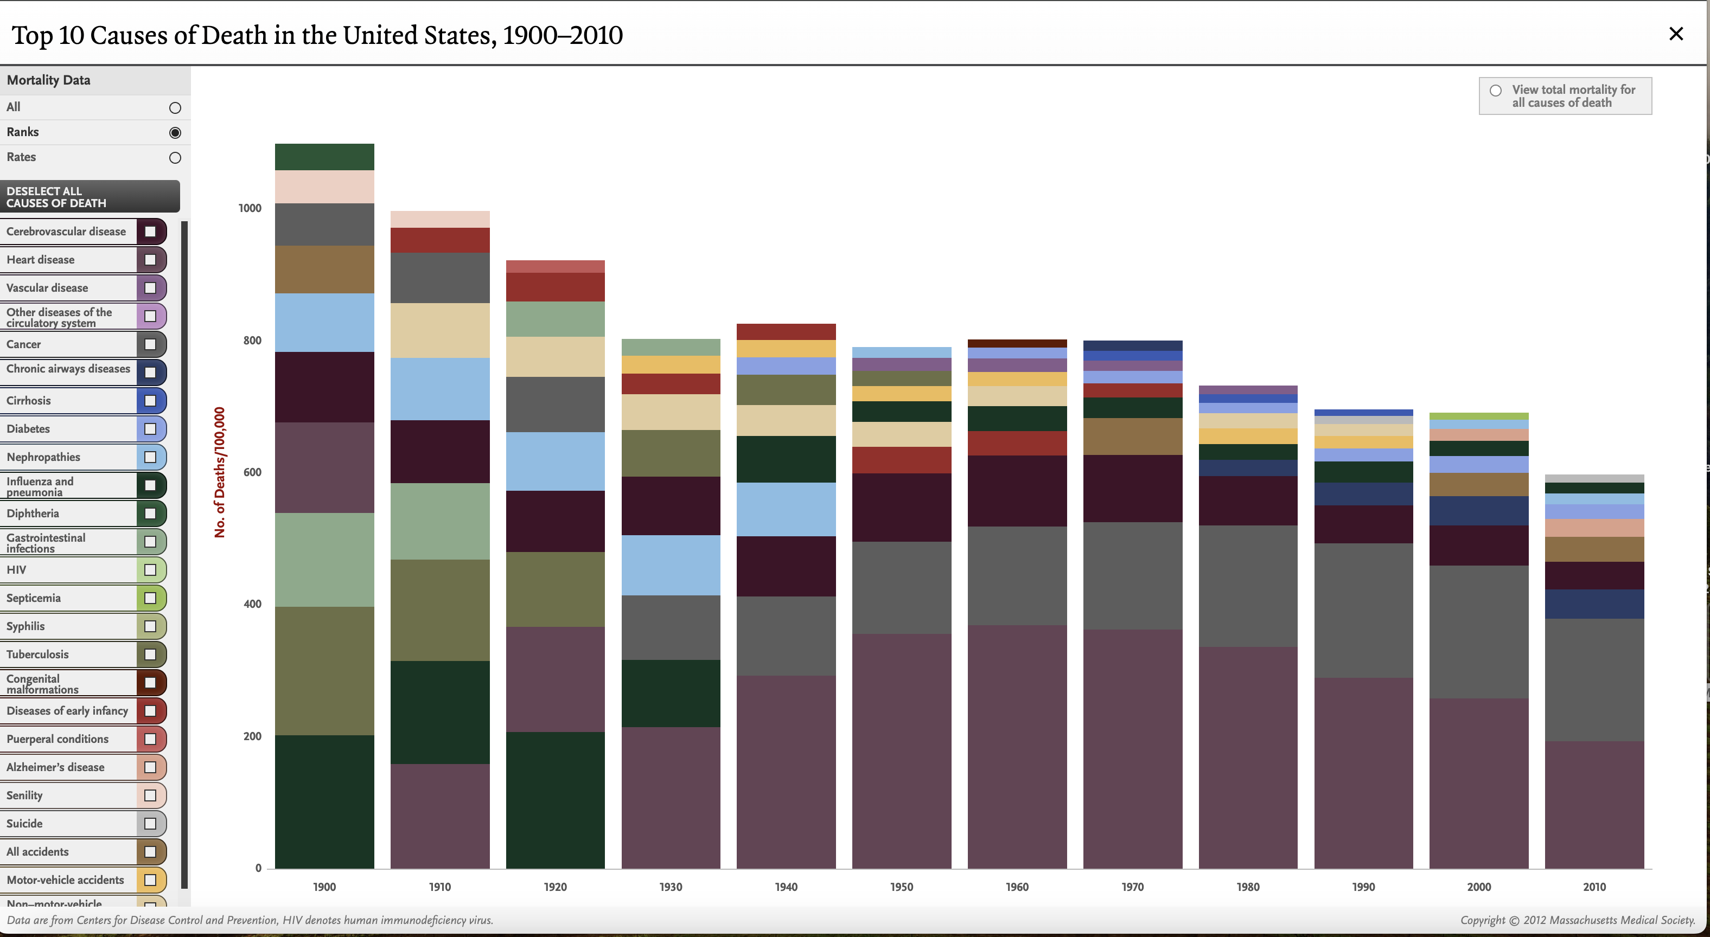
Causes of Death: 1900 - 2010
https://www.nejm.org/doi/full/10.1056/NEJMp1113569
Notes:
interactive version https://www.nejm.org/doi/full/10.1056/NEJMp1113569

Slide 40
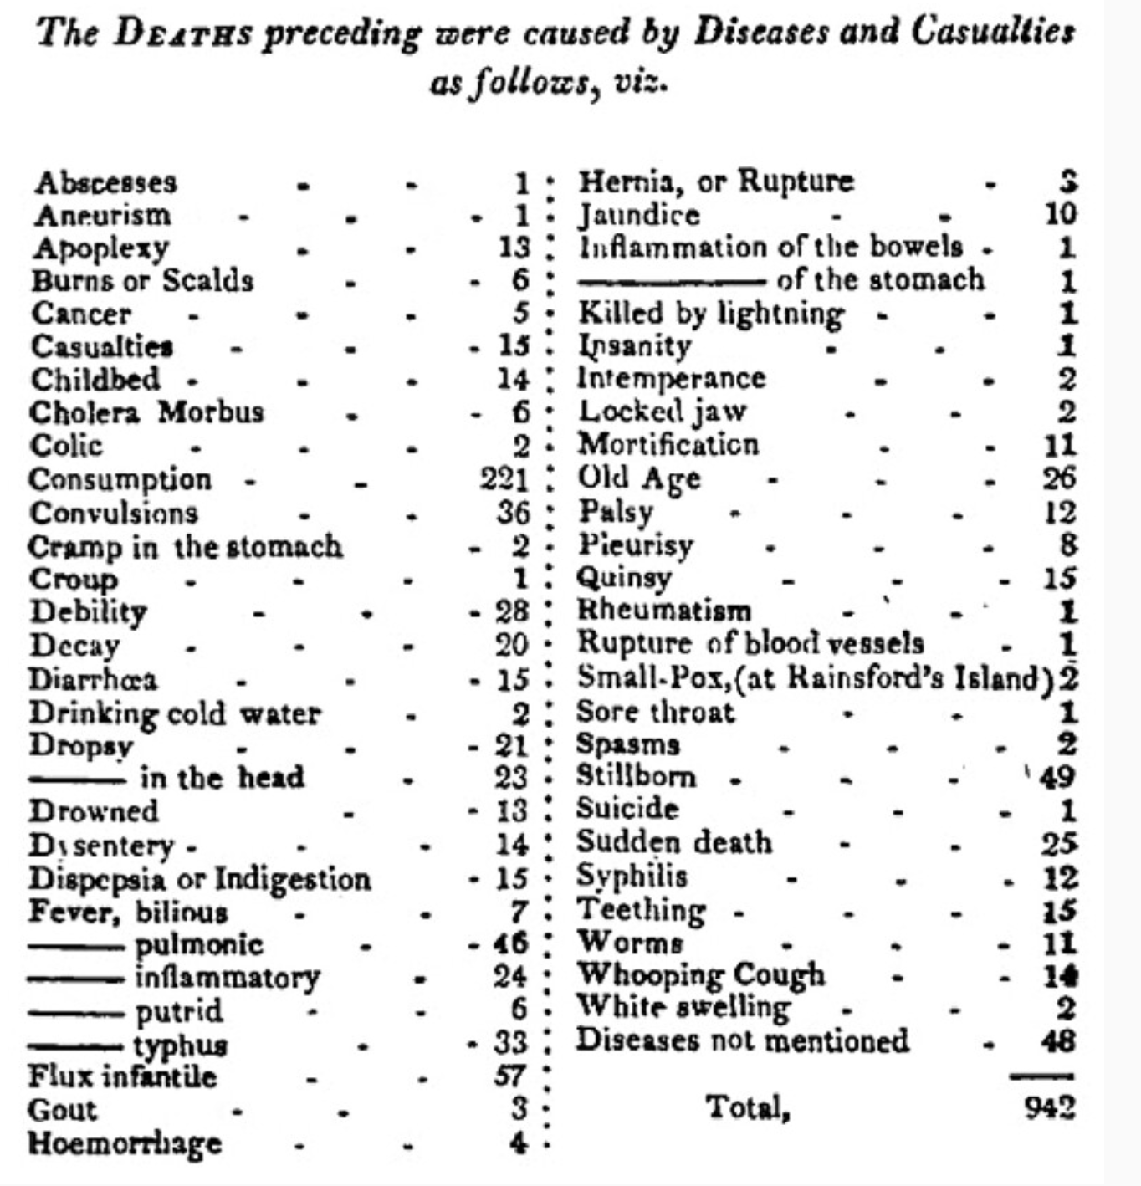
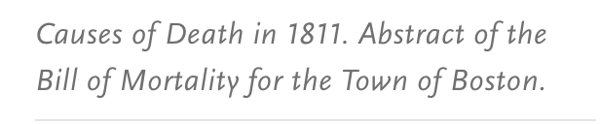
https://www.nejm.org/doi/full/10.1056/NEJMp1113569

Slide 41
Today
Motivation
Course Logistics
MLH as an Academic Discipline
US Healthcare System: High Order Bits
Last 100 Years
Next 100 Years
What makes MLH Unique?
Why Pittsburgh?
Notes:
That was the rear view mirror, let’s look out the windshield

Slide 42
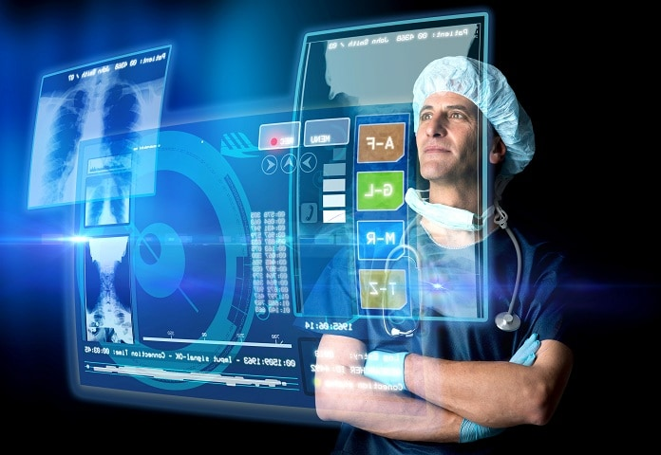
https://www.hhmglobal.com/knowledge-bank/articles/moving-beyond-buzzwords-enabling-the-future-of-healthcare-with-platform-technology
Notes:
Next few mins – highly opinionated view of the future.
The future is here, just unevenly distributed

Slide 43
1. Precision Medicine
Immunotherapy: checkpoint inhibitors, CAR-T cell therapy
Pharmacogenomics
CRISPR
Notes:
Checkpoint inhibitors: block checkpoint proteins (that act as ‘brakes’ on immune system). This allows T-cells to attack cancer cells. Keytruda, others.
CAR-T: modify patient’s own T-cells to attack tumor cells
Pharmacogenomics example: CYP2C19 gene indicates metabolization rate of Plavix (prevent blood clots)
CRISPR: therapy to modify existing genes. Approved for treating sickle cell anemia.
Lek 18 & 19

Slide 44
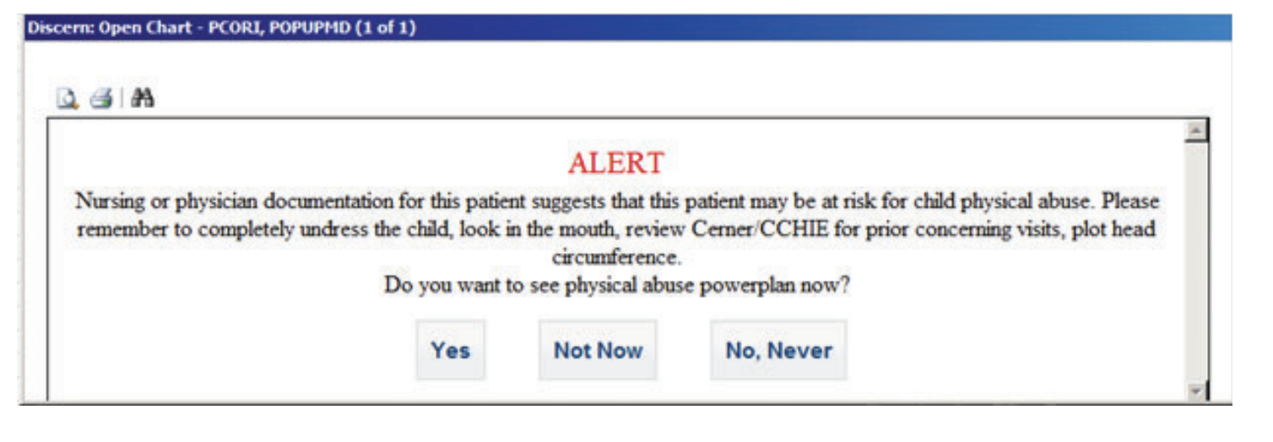
2. “Leveling Up” Clinicians
Problem: Providers have a wide variance in training, licensure, experience. How to ensure high-quality care for everyone?
Solution: CDS, BPA, pathways. What’s next?
https://pubmed.ncbi.nlm.nih.gov/29659856/
Notes:
Pressure to deliver care less expensively - moving from MD to PA to chatbot. How to retain quality/safety?
Lek 12

Slide 45
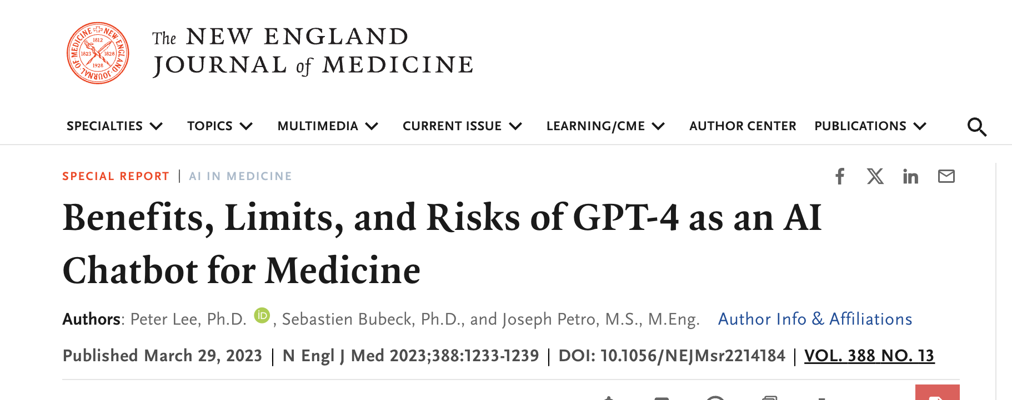
A 59-year-old man presented with a 3-week history of fatigue, light-headedness, and a gradually worsening bifrontal headache. Two weeks before presentation, he had watery diarrhea, including one episode of hematochezia, for 5 days. On the day of presentation, he had a sudden onset of dizziness that caused a fall, during which he neither struck his head nor lost consciousness. He reported that the dizziness resolved within 3 minutes. During a subsequent call to emergency medical services, he suddenly became unable to speak. His speech normalized within 5 minutes. He reported no fevers, abdominal or flank pain, nausea, vomiting, pale stools, bruising, rashes, palpitations, or sick contacts but did report having dark, red-tinged urine that began on the day of presentation.
What is your initial impression of this patient?
Based on the presented symptoms, the patient has a range of concerning features including headache, fatigue, lightheadedness, watery diarrhea, hematochezia, dizziness, sudden speech loss, and dark redtinged urine. The combination of these symptoms may indicate a systemic condition, such as an infection or autoimmune disorder, that is affecting multiple organ systems. The sudden onset of dizziness and speech loss are particularly concerning and could indicate a transient ischemic attack (TIA) or other neurological condition. Further evaluation, including physical examination and diagnostic tests, would be necessary to determine the underlying cause of these symptoms.
What should be done next in order to diagnose this patient?
The next steps in diagnosing this patient would include a thorough physical examination, taking a detailed history, and conducting diagnostic tests. These could include: 1. A neurological examination to assess for any deficits or abnormalities that could suggest a neurological condition, such as a transient ischemic attack (TIA). 2. Laboratory tests to evaluate for infection, inflammation, and other systemic conditions. These may include a complete blood count (CBC), erythrocyte sedimentation rate (ESR), C-reactive protein (CRP), liver and kidney function tests, and a urinalysis. 3. Imaging studies, such as computed tomography (CT) scan or magnetic resonance imaging (MRI) of the head to evaluate for any structural abnormalities that could explain the patient's symptoms. 4. Electrocardiogram (ECG) and/or echocardiogram to assess for any cardiac abnormalities that could be contributing to the patient's symptoms.
https://www.nejm.org/doi/full/10.1056/NEJMsr2214184
Notes:
Zero-shot application of commercial LLMs
Surprising, emergent behavior of LLMs

Slide 46
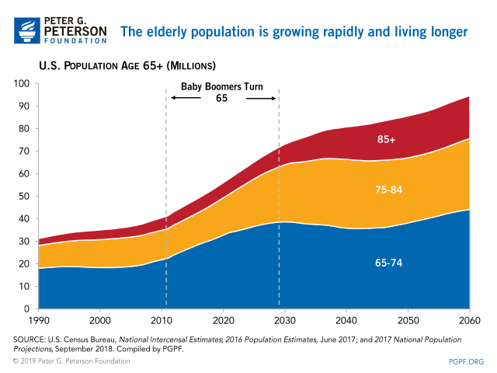
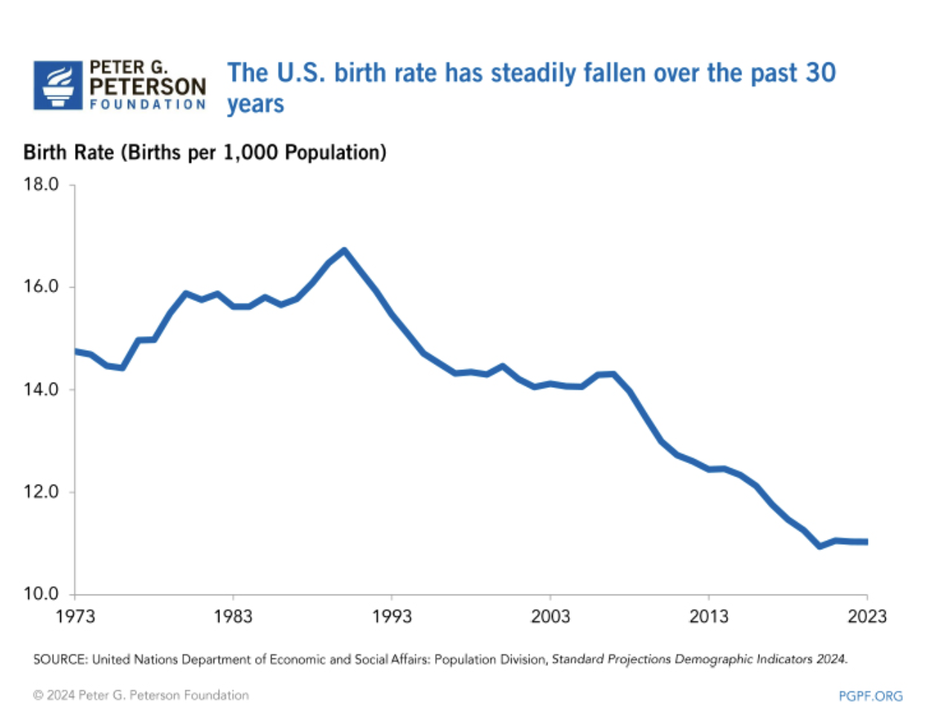
3. Demographic Shift
Remote monitoring
Fall detection
Rx management
Cognitive assessments
Cognitive therapy
https://www.pgpf.org/chart-archive/0045_elderly-population-trends

Slide 47
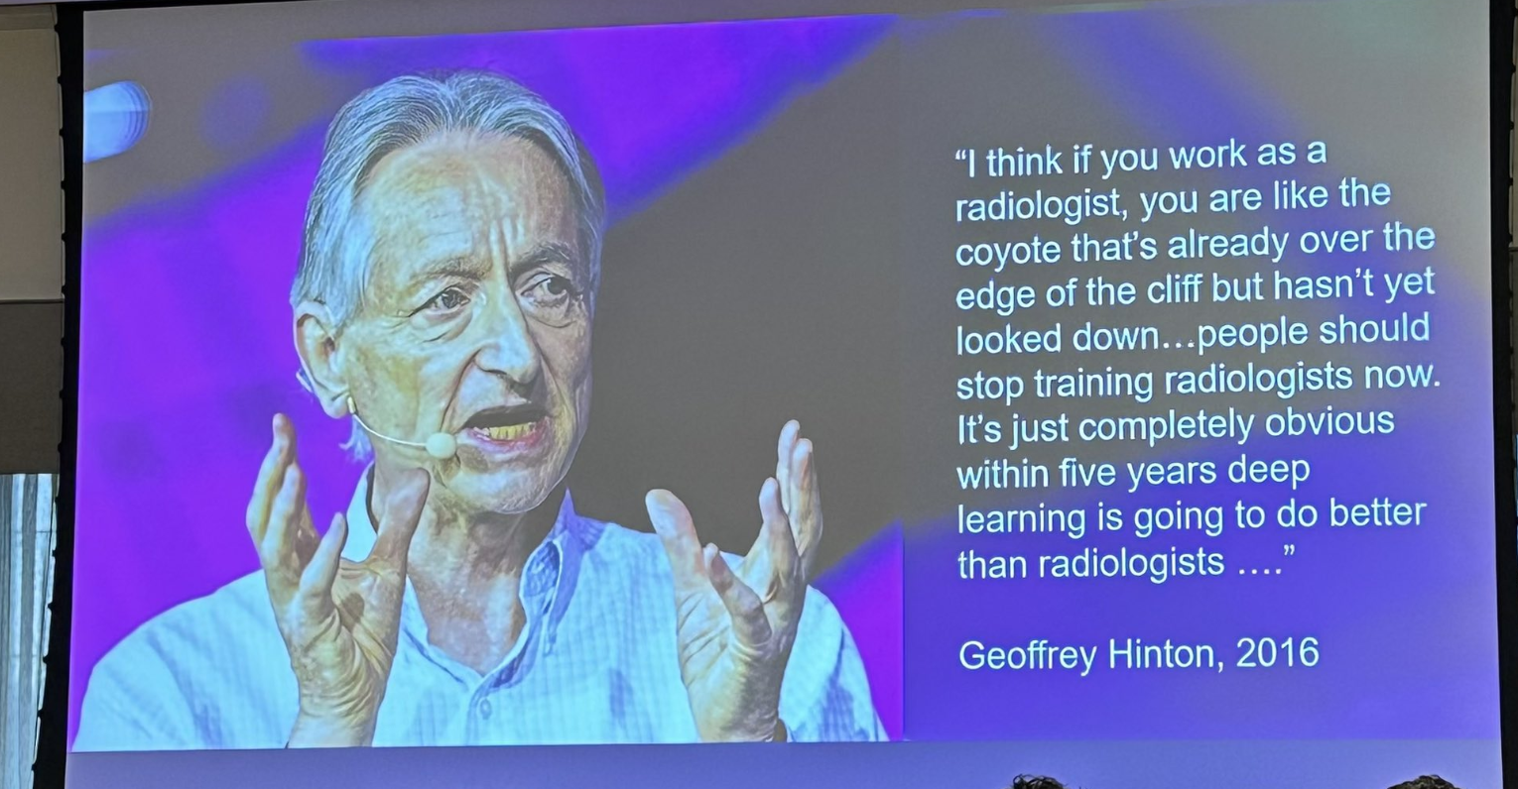
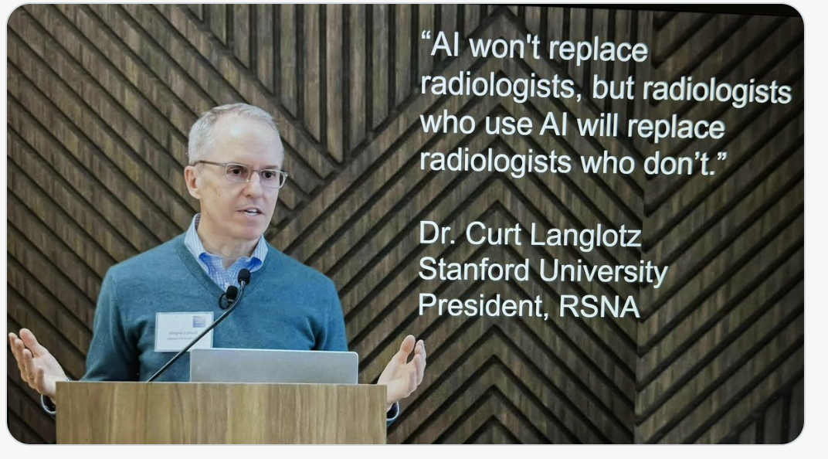
4. AI > Humans?
Notes:
Lek 14 will touch on this – “humans + AI”

Slide 48
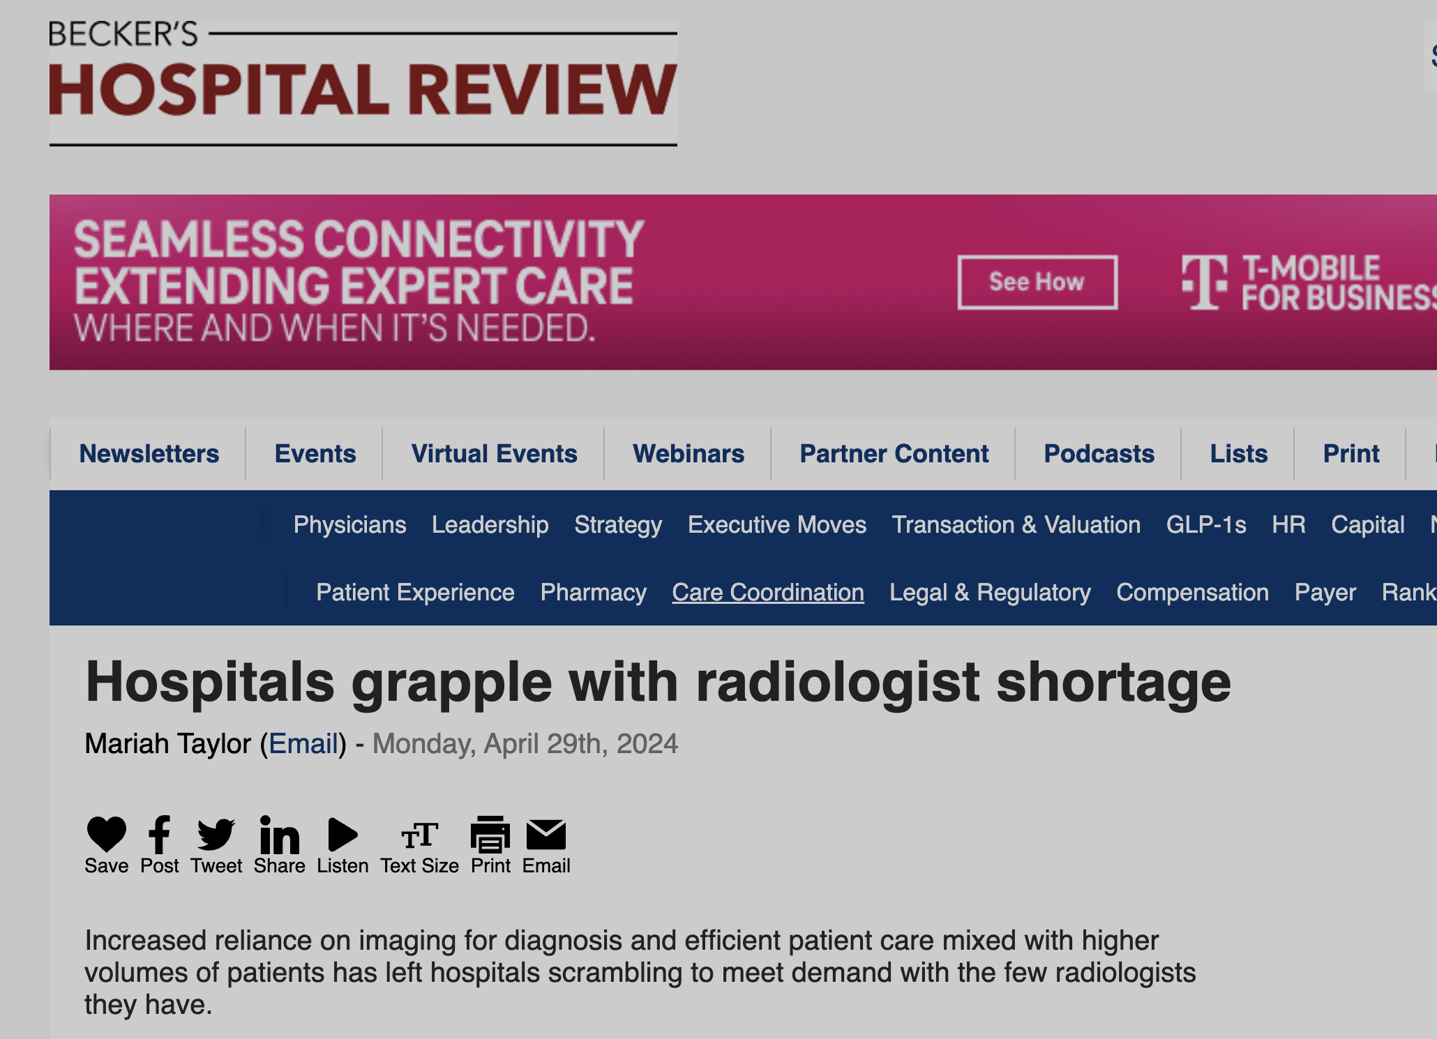
Notes:
A lot of self-congratulatory radiologists right now
Amara’s Law: “"We tend to overestimate the effect of a technology in the short run and underestimate the effect in the long run.” (attr to Bill Gates)

Slide 49
Today
Motivation
Course Logistics
MLH as an Academic Discipline
US Healthcare System: High Order Bits
Last 100 Years
Next 100 Years
What Makes MLH Unique?
Why Pittsburgh?
Notes:
Some unique challenges in MLH that you may not see in ML generally

Slide 50
Problem 1: Sparsity of Training Data
General
Medical
TEXT
UPMC’s Alexandria Charts (~400M)
CommonCrawl (>100B)
MIMIC (~3M)
PROPRIETARY
PUBLIC
JFT300M (300M)
ImageNet (14M)
CheXpert (224K)
IMAGES
Notes:
MIMIC is 33K times smaller than Common Crawl
Chexprt is 56x smaller than ImageNet
Another consideration: accessibility
Can go to s3://commoncrawl and download the data. Gated access to MIMIC.
JFT-300M: Internal Google dataset, pseudo public

Slide 51
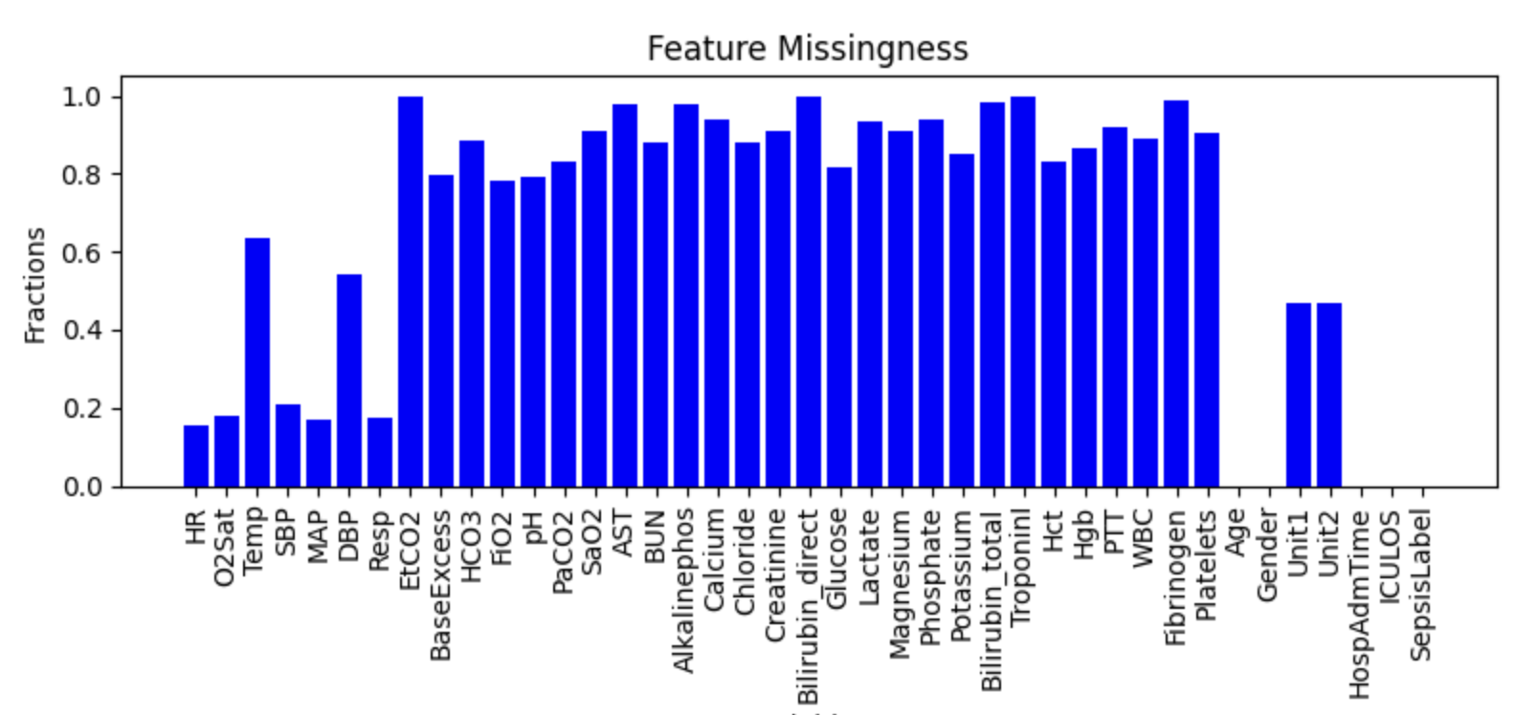
Problem 2: Missing Data
Notes:
This is actually related to one of your pset2 questions
MIMIC data – lab values that are missing .

Slide 52
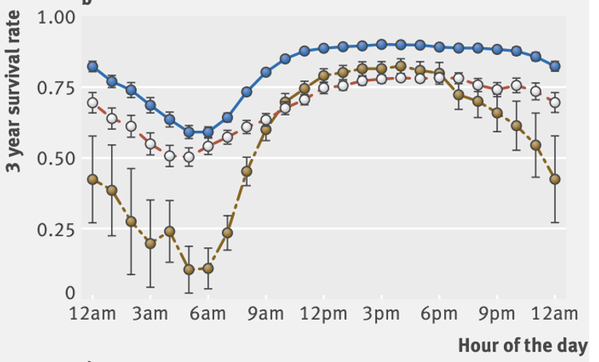
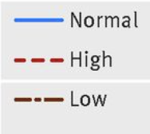
Problem 3: Biased Data
https://www.bmj.com/content/361/bmj.k1479
Notes:
Lab result for WBC count can be low, normal, high
You would think a normal result might be correlated with higher long-term survival, and you’d be right.
Notice: a normal result at 6AM predicts a lower long term survival than a low WBC at 3pm. Clearly a confounder in here…

Slide 53
Problem 4: Silo’ed Data
Administrative
Thin but longitudinal
Clinical
Deep but encounter-based

Slide 54
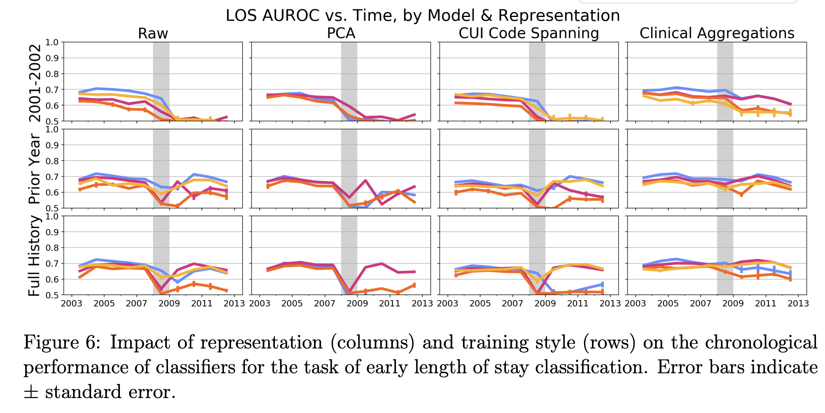
Problem 5: Distribution Shift
https://proceedings.mlr.press/v106/nestor19a/nestor19a.pdf
Notes:
Shown: models trained on MIMIC data.
Switch from one EHR to another (CareVue to Metavision)

Slide 55
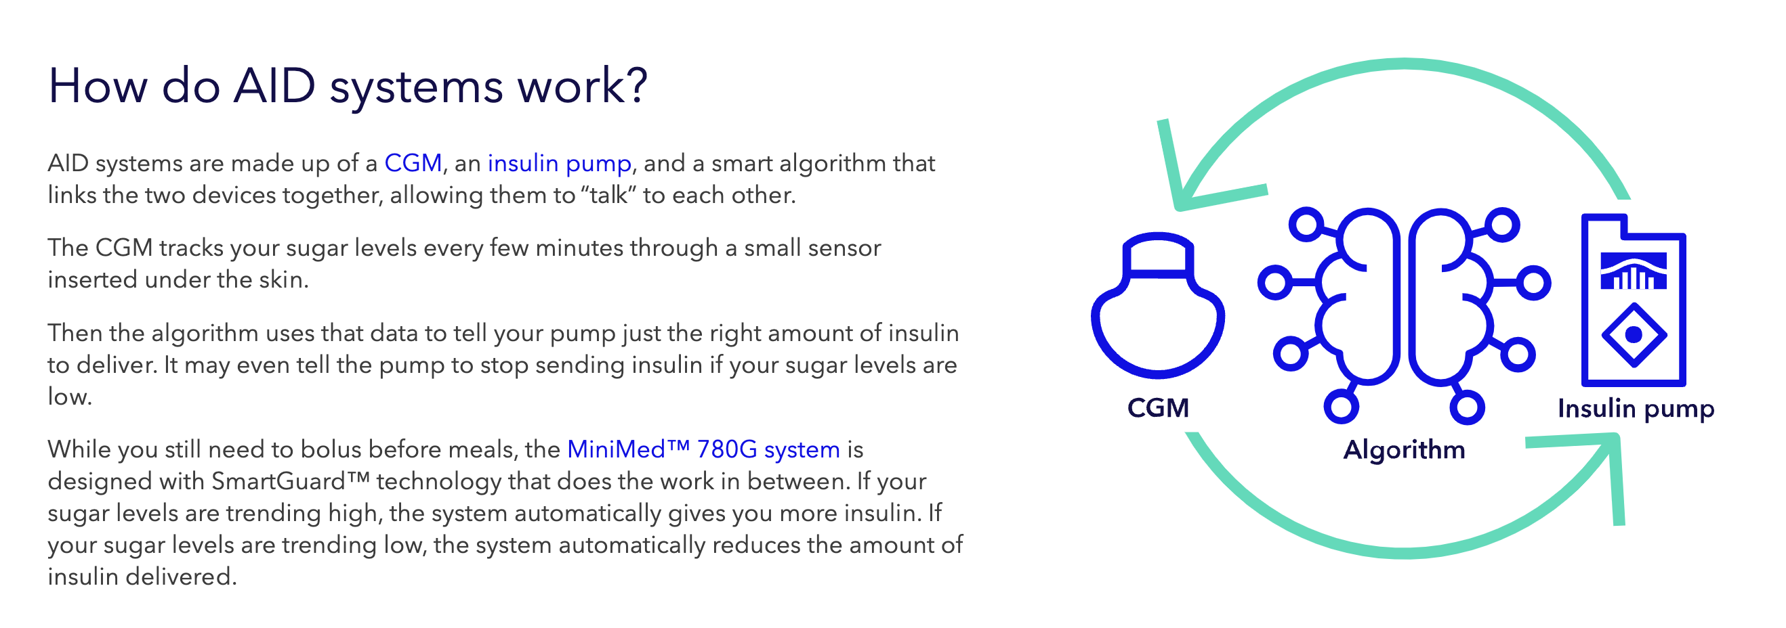
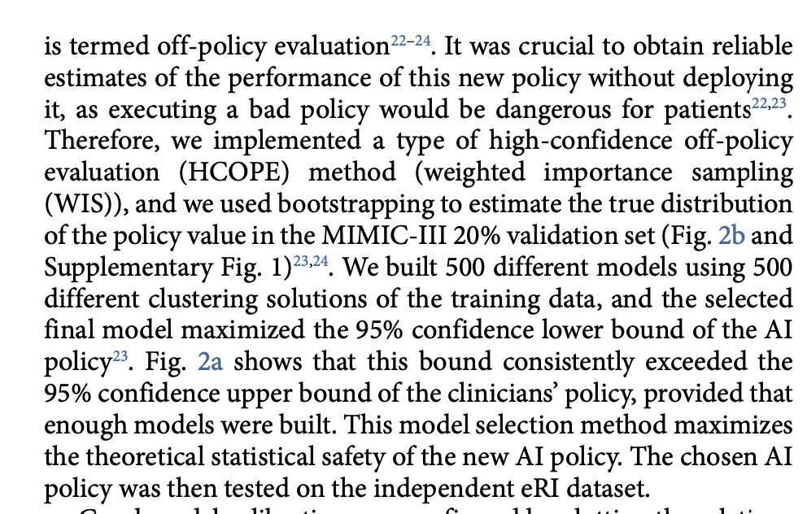
Problem 6: Life and Death Applications
https://www.medtronicdiabetes.com/treatments/automated-insulin-delivery
https://www.nature.com/articles/s41591-018-0213-5
Notes:
LEFT: Automated insulin delivery systems (AID) - simple rule-based algorithm to decide when to inject insulin. Can’t get it wrong.
RIGHT: Sepsis treatment. Topic of lecture 15

Slide 56
Today
Motivation
Course Logistics
MLH as an Academic Discipline
US Healthcare System: High Order Bits
Last 100 Years
Next 100 Years
What makes MLH Unique?
Why Pittsburgh?

Slide 57
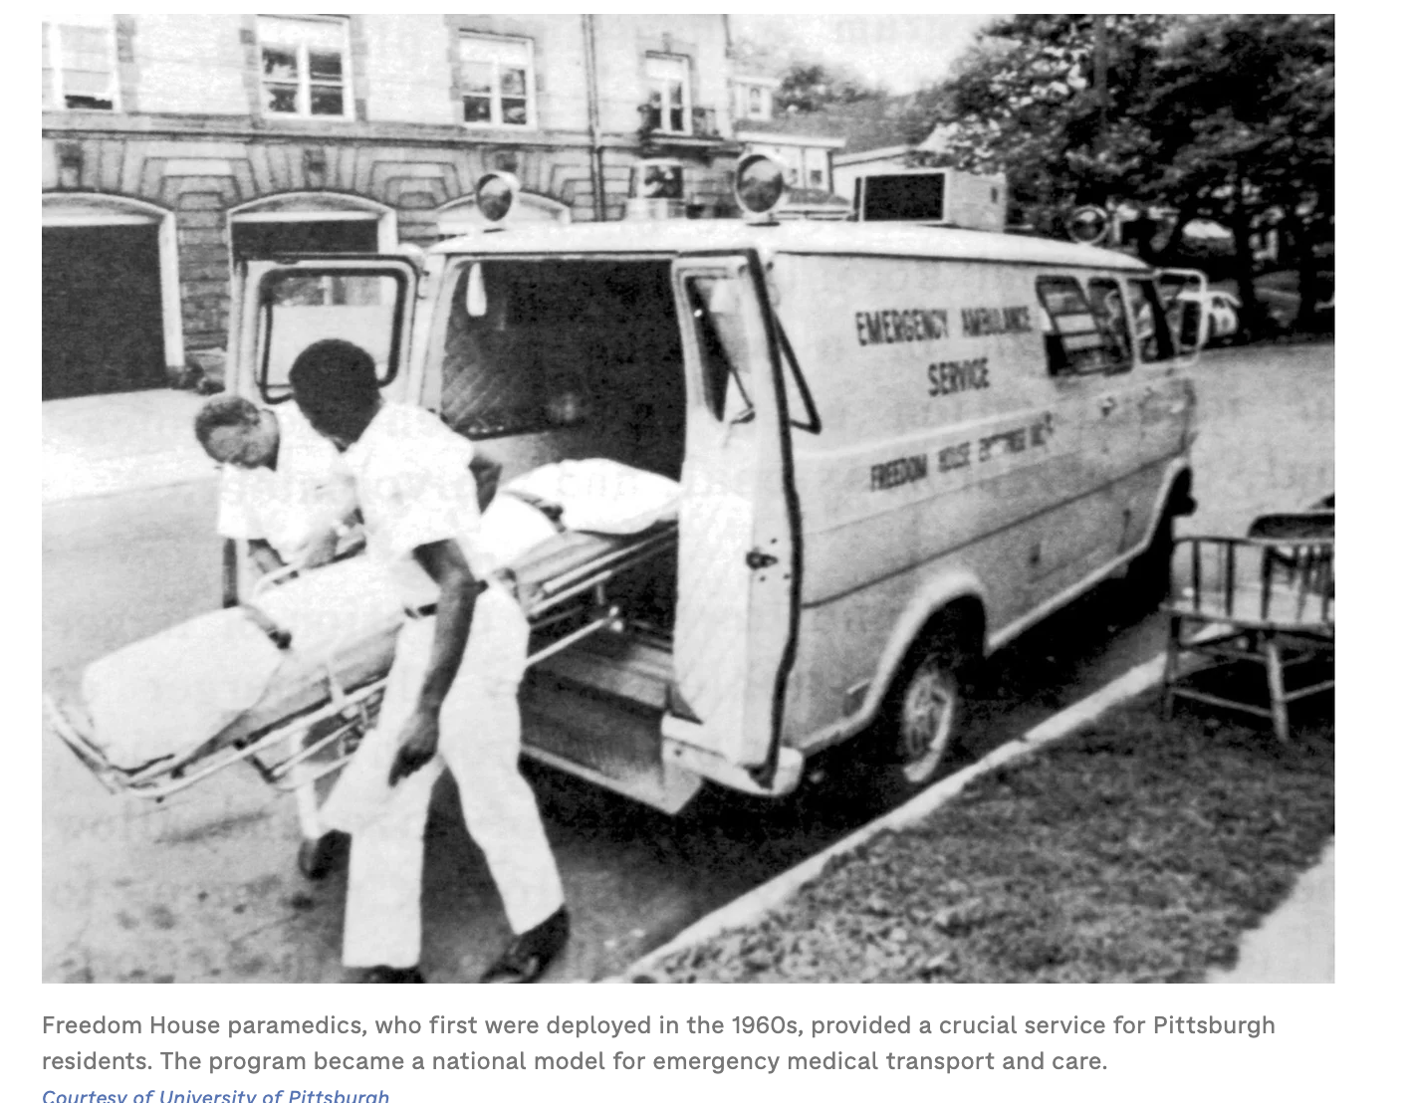
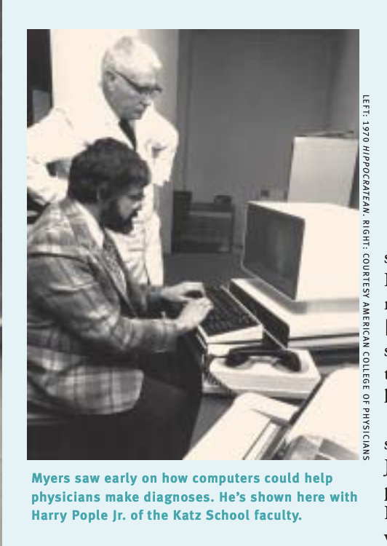
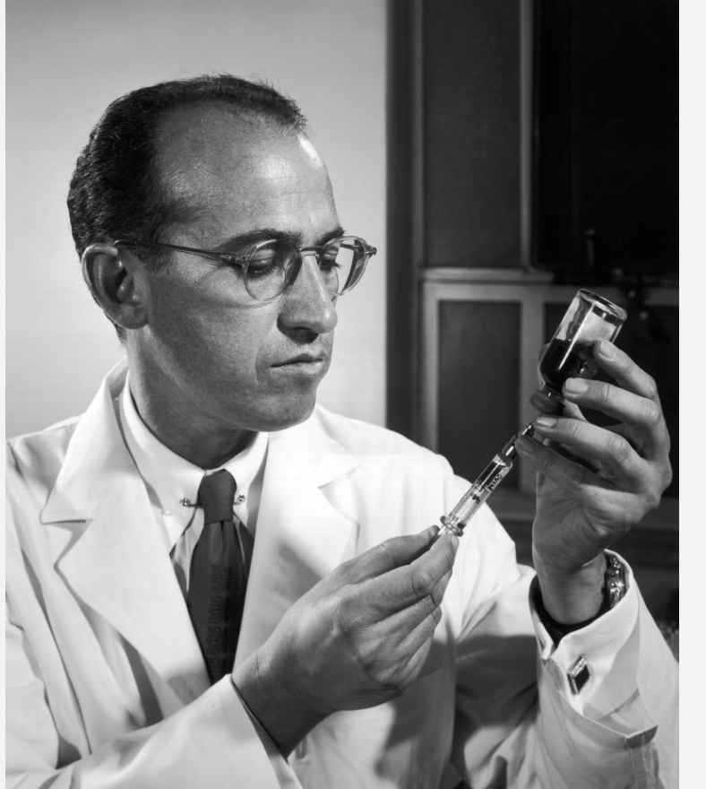
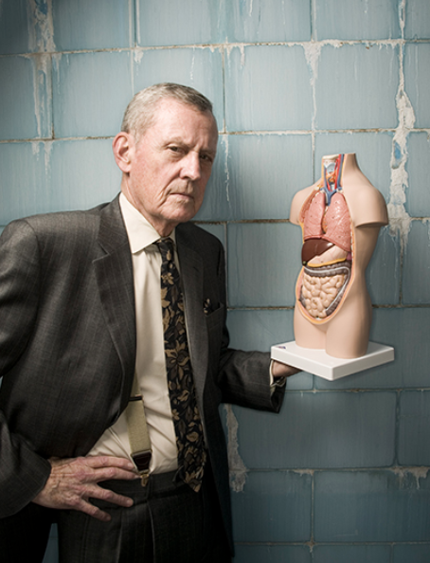
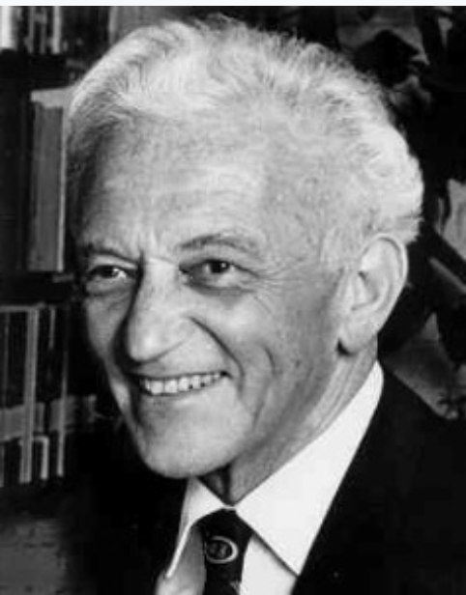
Why Pittsburgh?
Freedom House – first ambulance service staffed by trained paramedics
Jonas Salk – invented polio vaccine
Tom Starzl – ‘father of organ transplantation’
INTERNIST-1 came out of Pitt, Katz, CMU
Peter Safar – invented CPR.
Notes:
With the exception of INTERNIST-1, none of this is AI/ML, but it *is* healthcare innovation

Slide 58
EOL

